Slide 1


Rachid Berghout
DATA AND METHODS
TEMPORAL VARIATION OF CRIME IN TARTU AND TARTU MUNICIPALITY

Slide 2



Questions to answer
Temporal patterns
Factors
Land use
Find temporal patterns in crime occurrences
Find relationships between land use and crime occurrences
Find which factors affect crime occurrences

Slide 3
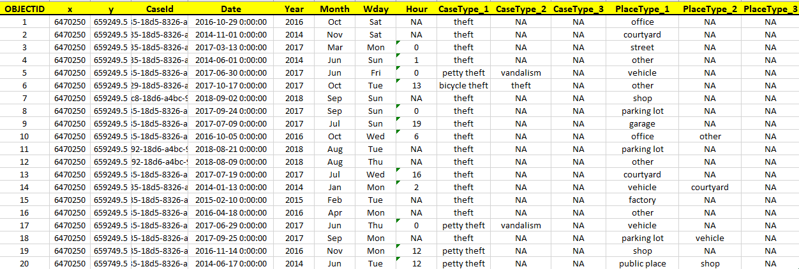
DATA
.csv table from police department
crime_data_kataster.csv

Slide 4
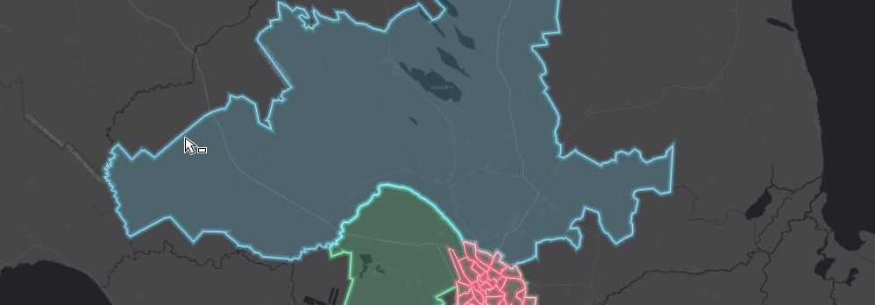
DATA
Datasets with administrative units
Tartu_area.shp

Slide 5
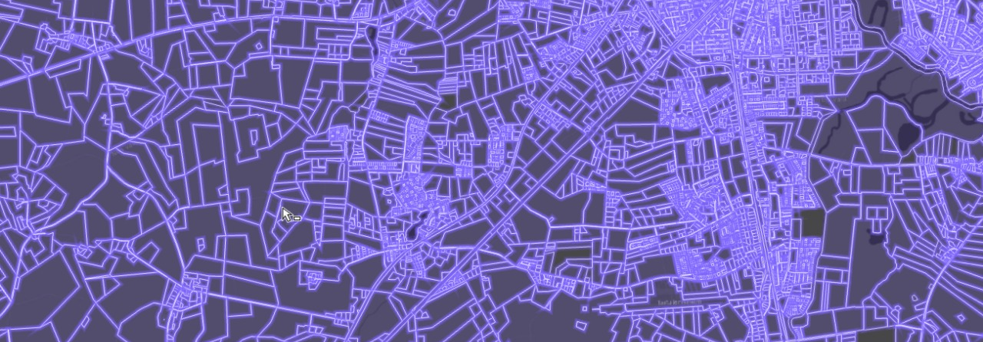
DATA
Dataset with cadastral information
SHP_KATASTRIYKSUS.shp

Slide 6
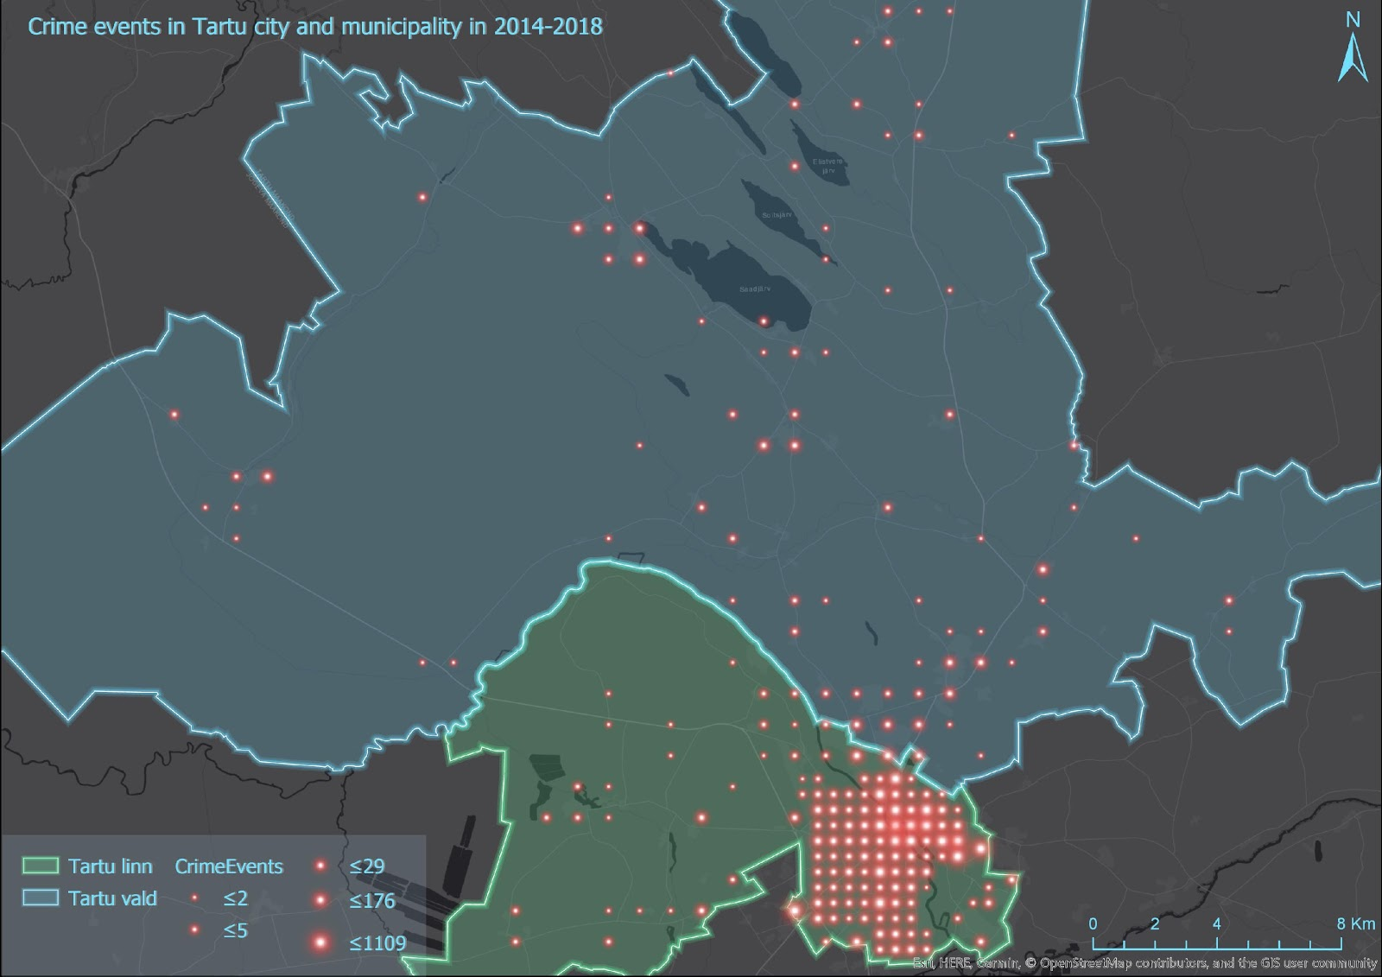
Crime Events in Tartu city and municipality
2014-2018

Slide 7
Crime/Days

Slide 8
Crime/Months

Slide 9
Crime/Years

Slide 10
Crime/Type
Against property
Theft
86%
Fire
0.5%
Scam
3%
Stolen sale
0.03%
Vandalism
9%
0
50
100

Slide 11
Crime/Type
Related to leisure activities
Traffic violation
76%
Traffic accident
3%
Narcotics
7%
Lost item
11%
0
50
100

Slide 12
Crime/Type
Involving violence
Bomb threat
3%
Case with firearm
1.5%
Physical abuse
40%
Robbery
53%
School violence
2%
0
50
100

Slide 13
Crime/Type
Other
Conflict/
Arbitrariness
0.5%
Public order violation
62%
Other
36%
0
50
100

Slide 14
Crime/Place
2437
1 Shop
2 Public place
2435
3 Street
908

Slide 15



METHODS
Descriptive statistics
to understand basic patterns in data
Poisson regression analysis
to find relationships between crime occurrences and other factors
Cross-tabulation
for analyzing amount of events per spatio-temporal unit

Slide 16
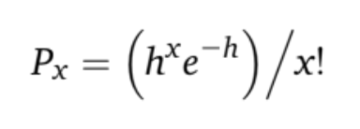

Poisson regression Analysis
Description
Example
X: any number of events
h: a particular outcome
- The odds a random event will occur during a particular time interval
- Binominal distribution
- Form of nonlinear regression that uses maximum likelihood estimation
Which means it depends on one or more independent variables
- Assumes the occurrence of one event does not influence another.
μ : the number of events
X : the “predictor value”
bo : the intercept
b1 : the coefficient of the first predictor
ln(μˆ) = b0 + b1X1

Slide 17
Huang F. L., Cornell D. G. (2012). Pick Your Poisson: A Tutorial on Analyzing Counts of Student Victimization Data, Journal of School Violence, 11:3, 187-206
Meneely P. M. (2016). Pick Your Poisson: An Educational Primer for Luria and Delbrück’s Classic Paper. Genetics, Vol. 202, 371–375. February 2016
References

Slide 18
Thank you!
Any questions?

